Slide 1
UAV Deconfliction
Design decision

Slide 2
## Project Structure
config
config.py – Configuration parameters for UAVs and simulation.
src
main.py – Main entry point for the UAV deconfliction system.
collision_detection.py – Collision detection logic and utilities.
handle_input_data.py – Handles input data for primary UAV.
simulationUavDB.py – Simulation UAV data definitions.
waypoint_plot.py – 3D plotting of UAV paths.
uav_info_def
__init__.py – Package initializer for UAV info definitions.
uav_info.py – UAV data structures (position, time window, etc.).
test
test_main.py – Unit tests for main functionality.

Slide 3
Control flow
main
Pass primary UAV data
Handle_Inputdata
- Get primary UAV data
Handle_collission
Detect_collision
Compare time window of primary UAV and Simulation UAV
If time window conflicts
Check if distance b/w primary and simulation UAV more than configured safeDistance
If distance b/w both UAVs less than safeDistance,
mark collision detection flag.
Print collision info
Print UAV info
Plot all UAVs path

Slide 4
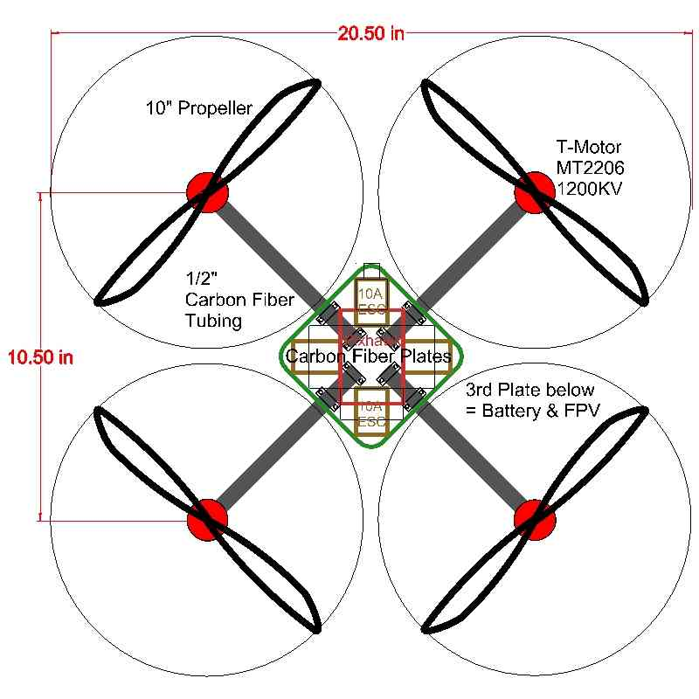
Calculating safe distance b/w two drones
radius1
radius2
x1
x2
Safe distance = 2*(radius1 + radius2)
Configurable as per requirement
(abs(x1 - x2) > safe distance) AND (abs(y1 - y2) > safe distance) AND (abs(z1 - z2) > safe distance)

